Slide 1
Cloud Resource Management and Scheduling
Session 09
Course : COSC6100001 - Cloud Infrastructure
D6825 - Samuel Philip

Slide 2
Learning outcomes
(C4) Analysis : identify problems that can be solved using cloud global infrastructure
(C2) Comprehension : group Classify real-worlds problems in accordance with cloud computing infrastructure
(C4) Analysis : analyze identifying problems and choose proper Cloud Services and Cloud Infrastructure

Slide 3
Outline
Policies and Mechanisms for Resource Management
Scheduling Algorithms for Computer Clouds
Cloud Resource Utilization and Energy Efficiency

Slide 4
Policies and Mechanism for Resource Management

Slide 5

Policies and Mechanism for Resource Management
A policy sets guiding principles, while a mechanism implements the policy.
- Policy Classes: Admission control (preventing system overload/violation of high-level policies), capacity allocation (resource assignment to individual service instances), load balancing, energy optimization, and QoS guarantees.
This Photo by Unknown Author is licensed under CC BY-SA

Slide 6

Policies and Mechanism for Resource Management
Four basic mechanism
A key goal is the minimization of cost, especially through the minimization of energy consumption. Basic Mechanisms For The Implementation Of Resource Management Policies includes:
Control theory: Uses feedback to predict local behavior and guarantee stability.
Machine learning: Advantageous because it does not require a system performance model.
Utility-based: Requires a performance model to correlate user-level performance with cost.
Market-oriented/economic: Does not require a system model (e.g., combinatorial auctions).

Slide 7
Scheduling Algorithms for Computer Clouds

Slide 8
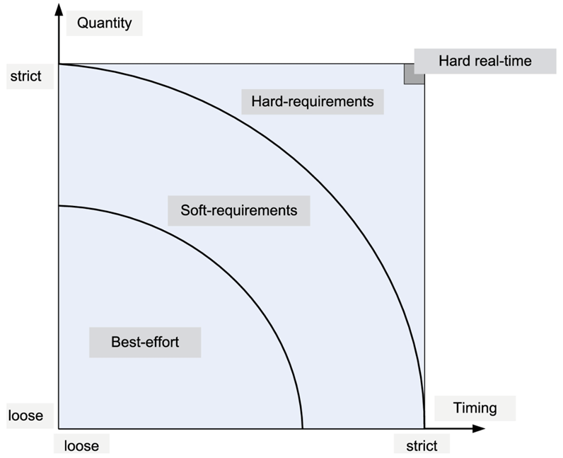
Scheduling Algorithms
Objectives: Must be efficient, fair, and starvation-free.
CPU scheduling supports the virtualization of a processor, the individual threads acting as virtual processors; a communication link can be multiplexed among number of virtual channels, one for each flow.
Batch systems aim to maximize throughput and minimize turnaround time.
Real-time systems aim to meet deadlines and be predictable.
Scheduling policies address (a) the quantity of resources allocated, and (b) the timing of access.
Notes:
Schedulers for systems supporting a mixture of tasks, some with hard real-time constraints, others with soft, or no timing constraints, are often subject to contradictory requirements.
Some schedulers are preemptive, allowing a high-priority task to interrupt the execution of a lower priority one; others are nonpreemptive.
Two distinct dimensions of resource management must be addressed by a scheduling policy: (a) the amount/quantity of resources allocated; and (b) the timing when access to resources is granted.

Slide 9
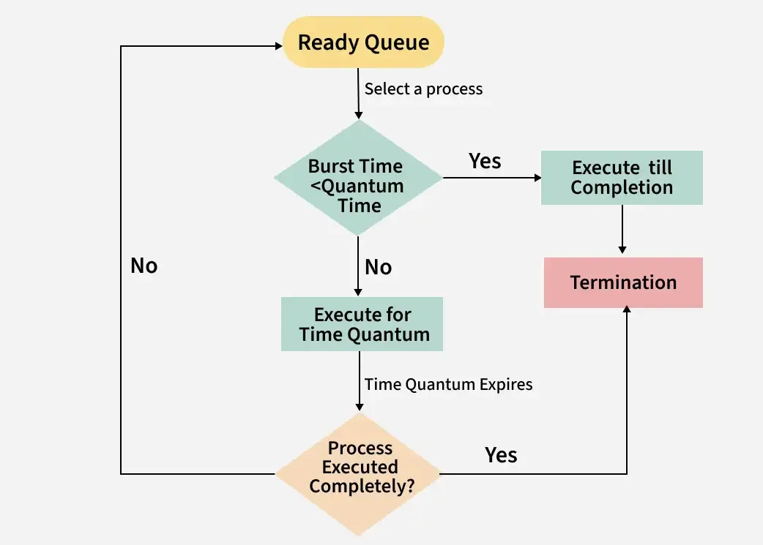
Scheduling algorithms
for best-effort applications
There are 3 main types of scheduling algorithms: best-effort, real-time, integrated
The commonly used for best-effort are
Round-robin
FCFS
Shortest-Job-First (SJF)
Priority Algorithms.
Round robin flowchart
Notes:
Round Robin Scheduling is a method used by operating systems to manage the execution time of multiple processes that are competing for CPU attention. It is called "round robin" because the system rotates through all the processes, allocating each of them a fixed time slice or "quantum", regardless of their priority.
The primary goal of this scheduling method is to ensure that all processes are given an equal opportunity to execute, promoting fairness among tasks.

Slide 10
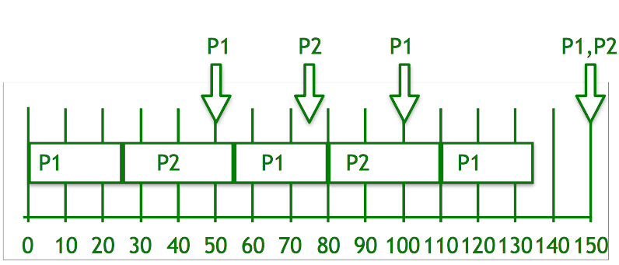
Scheduling algorithms
for real-time applications
Example for real-time application
Earliest Deadline First (EDF)
Rate Monotonic Algorithms (RMA).
EDF illustration
Notes:
Earliest Deadline First (EDF) is an optimal dynamic priority scheduling algorithm used in real-time systems.
It can be used for both static and dynamic real-time scheduling.
EDF uses priorities to the jobs for scheduling. It assigns priorities to the task according to the absolute deadline. The task whose deadline is closest gets the highest priority. The priorities are assigned and changed in a dynamic fashion. EDF is very efficient as compared to other scheduling algorithms in real-time systems. It can make the CPU utilization to about 100% while still guaranteeing the deadlines of all the tasks.

Slide 11
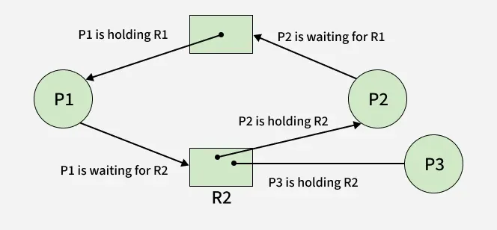
Scheduling algorithms
for Integrated applications
Example for Integrated application
Resource Allocation/Dispatching (RAD)
Rate-Based Earliest Deadline (RBED).
Resource allocation graph

Slide 12
Cloud Resource Utilization and Energy Efficiency

Slide 13

Cloud Elasticity and Over Provisioning
Elasticity: Guarantees resources are allocated when needed and released when done, ensuring users pay only for used resources.
Over-provisioning: Cloud providers must invest in a larger infrastructure than typical workload warrants to support elasticity, resulting in low average cloud server utilization.
Elasticity is based on overprovisioning and on the assumption that there is an effective admission control mechanism. Another assumption is that the likelihood of all running applications dramatically increasing their resource consumption at the same time is extremely low.

Slide 14
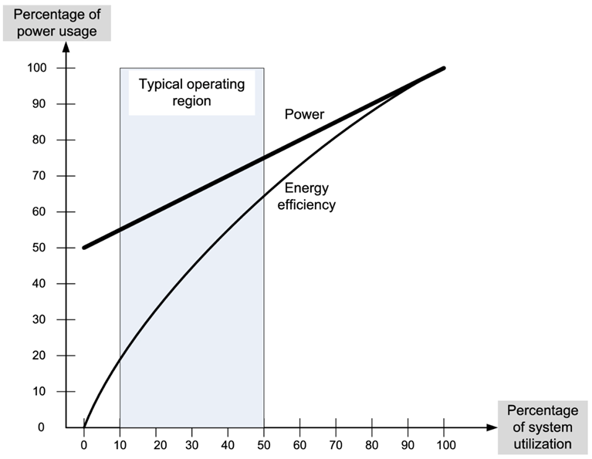
Cloud Elasticity and Over Provisioning
Energy saving strategies
Elasticity and over-provisioning allows for better energy consumption
Employing energy-aware load balancing and scaling policies to identify servers operating outside their optimal regime and potentially switching them to a sleep state.
Techniques include concentrating workload onto fewer disks, using replication (which can reduce power requirements by up to 31%), and data migration controlled by short-term and long-term optimization algorithms.
Notes:
The effort to reduce the energy use is focused on the computing, networking, and storage activities of a data center.
A strategy to reduce energy consumption is to concentrate the workload on a small number of disks and allow the others to operate in a low-power mode.
One of the techniques to accomplish this is based on replication. A replication strategy based on a sliding window; measurement results indicate that it performs better than LRU, MRU, and LFU9 policies for a range of file sizes, file availability, and number of client nodes and the power requirements are reduced by as much as 31%.

Slide 15
Exercise
Discuss how a bad scheduling affects energy consumption and what would be the effects on the environment

Slide 16
References
Marinescu, Dan C. (2022). Cloud Computing Theory and Practice: 3rd Edition. Morgan Kaufmann Publishers. ISBN: 978-0-323-85277-7

Slide 17
Thankyou

